Slide 1

SmartMeds-Medicine Dispenser
Name:Sumukha ML
SRN: PES1PG24CA184
Guide: Mr. Santosh Katti
Department of Computer Applications

Slide 2

SmartMeds
Abstract
Medication non-adherence is a significant challenge, especially among elderly and visually-impaired patients. SmartMeds is an intelligent medicine dispensing system that integrates voice commands, speech recognition, and web-based control with a Raspberry Pi–powered hardware dispenser. The system allows users or caregivers to upload prescriptions via the web application, and the Raspberry Pi fetches instructions, processes voice input, and dispenses medicines accurately.
The solution leverages IoT communication, Python-based ASR, and secure web APIs to ensure seamless interaction. The dispenser provides scheduled reminders, voice instructions, real-time logs, and a safe, tamper-proof dispensing mechanism. This project improves medication adherence, reduces human error, and enhances accessibility for individuals with disabilities.

Slide 3
SmartMeds
Problem Statement
Medication errors, forgetfulness, poor visibility of pill labels, and complex dosage schedules lead to major health risks. Elderly patients or patients with chronic diseases often forget dosages, leading to complications.
Key real-world issues:
Missed or incorrect dosage.
Patients unable to read prescriptions.
Lack of real-time caregiver monitoring.
Zero voice-controlled, low-cost dispensers available

Slide 4
SmartMeds
Proposed Solution
Voice-controlled medicine dispensing.
Web-based interface for caregivers to upload schedules.
Raspberry Pi executes dispensing actions.
Audio reminders and confirmations.
Secure communication between cloud and hardware.

Slide 5
SmartMeds
Purpose
Improve medication adherence.
Provide a low-cost, accessible dispenser.
Enable remote monitoring and control.
Provide voice assistance to visually-impaired patients.

Slide 6
SmartMeds
Scope
The system includes:
Web app (authentication, schedule creation, logs).
Hardware dispenser (Pi + servo motors+ DC Motors).
Voice command processing.
Real-time API communication.

Slide 7
Literature Survey
Paper 1
Title: An Intelligent Pill Dispenser Using IoT for Chronic Patients
Conference: IEEE International Conference on IoT and Applications
Year: 2020
Authors: S. T. George et al.
Summary:
Introduces an IoT pill dispenser with scheduling, reminders, and remote caregiver monitoring. Uses sensors to detect pill removal.
Relevance:
Matches SmartMeds IoT + cloud design.

Slide 8
Literature Survey
Paper 2
Title: Smart Medicine Box for Automatic Medication Reminder and Monitoring
Conference: IEEE International Conference on Communication and Electronics Systems
Year: 2021
Authors: N. R. Prasad et al.
Summary:
Discusses an automated system with notification alerts, pill schedule management, and cloud connectivity.
Relevance:
Similar scheduling and reminder module as SmartMeds.

Slide 9
Literature Survey
Paper 3
Title: IoT Based Medication Reminder System for Elderly People
Conference: IEEE International Conference on Computing Methodologies
Year: 2020
Authors: A. Chatterjee et al.
Summary:
Focuses on an IoT-enabled system for scheduling reminders through mobile apps and sensors.
Relevance:
SmartMeds uses similar caregiver-to-device communication.

Slide 10
Literature Survey
Paper 4
Title: Voice Enabled Assistive Health Monitoring System
Conference: IEEE International Conference on Inventive Systems and Control
Year: 2021
Authors: V. S. Reddy et al.
Summary:
Develops a voice-controlled health monitoring system for elderly patients.
Relevance:
Supports SmartMeds’ use of speech recognition & assistive voice features.

Slide 11
Literature Survey
Paper 5
Title: IoT Based Smart Pill Box with Real-Time Monitoring
Conference: IEEE International Conference on Intelligent Sustainable Systems
Year: 2022
Authors: M. Shankar et al.
Summary:
Implements a smart pillbox with IR sensors, alerts, and cloud connectivity for real-time logs.
Relevance:
Matches SmartMeds’ verification sensor system.

Slide 12
Literature Survey
Paper 6
Title: RFID and IoT Based Smart Medicine Dispenser System
Journal: IEEE Access (Open Access)
Year: 2021
Authors: P. Singh et al.
Summary:
A secure IoT medicine dispenser using RFID authentication and remote alerts.
Relevance:
Useful for SmartMeds’ future upgrade: tamper-proof security.

Slide 13
Literature Survey
Paper 7
Title:Machine Learning Based Elderly Healthcare Assistance System
Conference: IEEE International Conference on Machine Learning and Applications
Year: 2022
Authors: J. Park et al.
Summary:
Uses ML models to track and predict elderly behavior patterns.
Relevance:
SmartMeds can integrate ML for adherence prediction & dosage optimization.

Slide 14
Literature Survey
Paper 8
Title: Deep Learning Based Voice Recognition for Assistive Devices
Conference: IEEE International Conference on Artificial Intelligence and Data Engineering
Year: 2020
Authors: H. Lin et al.
Summary:
Uses CNN/RNN models for offline speech recognition in assistive devices.
Relevance:
Supports SmartMeds’ ASR module (Vosk/Whisper).

Slide 15
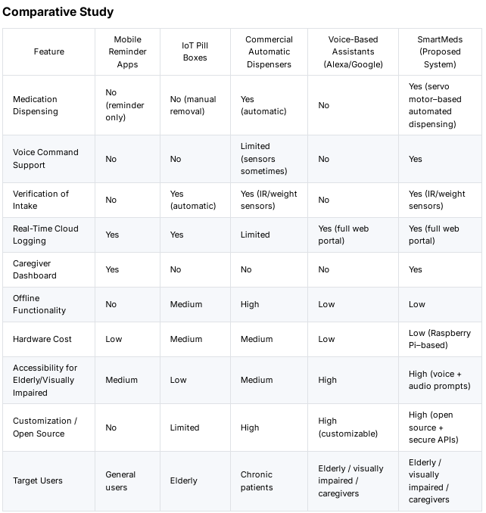
Comparative Study

Slide 16
Tools and Technologies
Hardware
Raspberry Pi 3B+
Servo motors
DC motor
IR sensor
Audio speaker
Software
Python 3
Flask/FastAPI backend(3.0)
Web app (React 19.x)
Firebase Realtime DB
Speech Recognition (Vosk 0.3.45)
Raspberry Pi OS(Bookworm)
HTTP3 communication

Slide 17
SmartMeds
Functional requirements
User Authentication and Authorisation – Provides secure cloud-based login with role-based access to protect sensitive medical data.
Patient Profile Management – Enables caregivers to create and manage individual patient profiles with personal and medical details.
Medicine Assignment and Scheduling – Allows caregivers to assign medicines with dosage and timing, supporting real-time updates from the cloud.
Voice Command Recording – Allows patients to record medicine requests through a simple and accessible web-based voice interface.
Speech-to-Text Conversion – Converts patient voice commands into text for accurate system interpretation.

Slide 18
SmartMeds
Functional requirements
NLP-Based Intent Detection – Analyzes converted text to understand the patient’s intended action using natural language processing.
Medicine Name Recognition and Matching – Accurately identifies spoken medicine names and matches them with prescribed medicines.
Validation of Dispensing Requests – Ensures medicines are dispensed only if the request is valid, scheduled, and not previously fulfilled.
Automated Medicine Dispensing – Uses Raspberry Pi–controlled motors to dispense the correct medicine automatically.
Real-Time Cloud Synchronisation – Keeps the web application and hardware system synchronized with live cloud updates.

Slide 19
SmartMeds
Functional requirements
Alerts and Notifications – Notifies users through audio, LED, and LCD alerts during dispensing operations.
Error Detection and Handling – Detects system faults and logs errors in the cloud for prompt resolution.

Slide 20
SmartMeds
Non-Functional requirements
Performance Requirements – Ensures fast response to voice commands, quick cloud communication, and real-time system synchronisation.
Reliability Requirements – Guarantees accurate and consistent medicine dispensing with automatic recovery from failures or network issues.
Availability Requirements – Maintains continuous system operation with minimal downtime, even during power or connectivity interruptions.
Security Requirements – Protects user data through secure authentication, role-based access control, and encrypted communication.
Privacy Requirements – Preserves patient confidentiality by limiting data collection and restricting access to authorised users only.
Usability Requirements – Provides a simple, intuitive interface with voice interaction, visual indicators, and clear audio guidance.
Accessibility Requirements – Supports users with physical or sensory impairments through voice control and clear feedback mechanisms.
Scalability Requirements – Allows easy expansion to support more users and future features without affecting system performance.

Slide 21
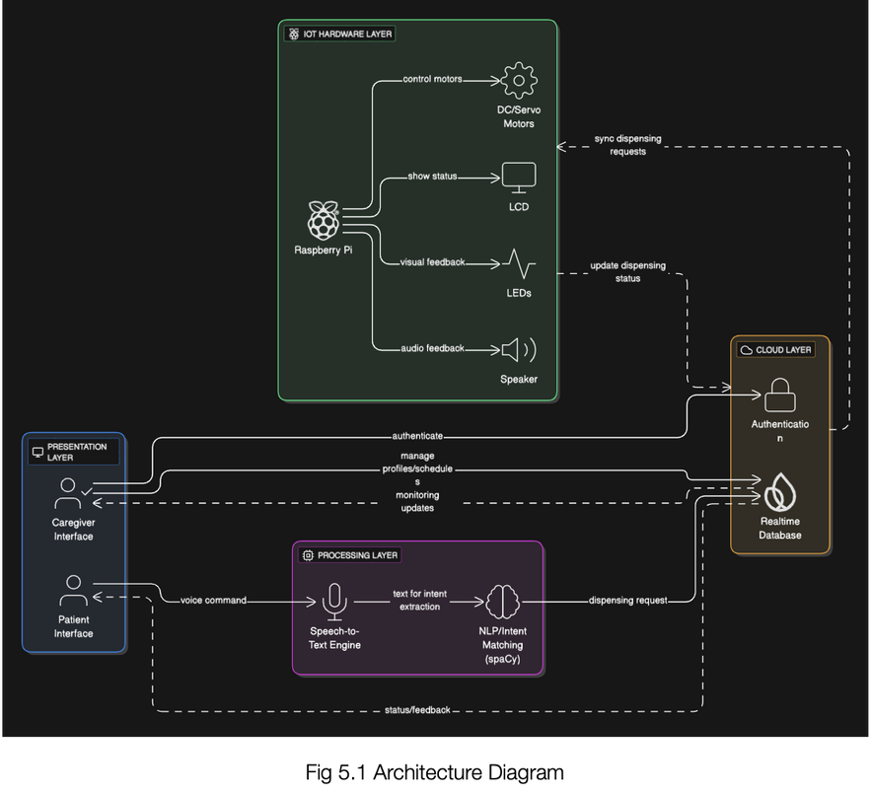
Design- High level Diagrams
Architecture Diagram

Slide 22
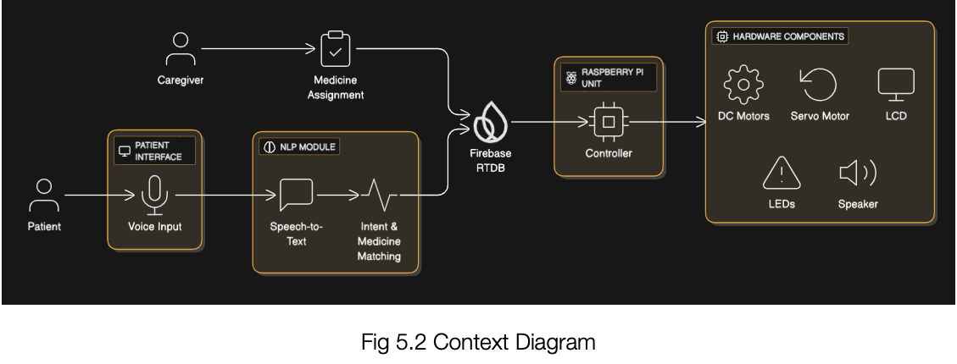
Design- High Level Diagrams
Context Diagram

Slide 23
SmartMeds
Pseudo Code
App():
state: authView, user, userType
onMount:
init Firebase Auth
onAuthStateChanged:
if logged in:
user ← currentUser
userType ← RTDB(users/uid/userType)
authView ← home
else:
authView ← login
logout():
signOut()
reset states
render:
loading → Spinner
login/signup → Auth Pages
home → Patient or Caregiver Dashboard

Slide 24
SmartMeds
Pseudo Code
AudioRecorder(user):
state: isRecording, audioBlob
startRecording():
request microphone
start MediaRecorder
stopRecording():
stop recorder
upload audio to backend

Slide 25
SmartMeds
Pseudo Code
processAudio(audio):
send audio → backend (/process_audio)
receive:
transcript
medicine_name
dosage
slot
if medicine detected:
notify dashboard

Slide 26
SmartMeds
Pseudo Code
MedicineDisplay(user):
onMount:
listen RTDB(medicines/user.uid)
update medicine list
sendInstruction(medicine, dosage):
POST → backend (/send_instruction)
show success message

Slide 27
SmartMeds
Pseudo Code
//Audio Processing
POST /process_audio
input: audio file + patient_uid
convert audio → WAV
speech → text (Speech Recognition)
extract:
medicine name
dosage

Slide 28
SmartMeds
Pseudo Code
//NLP and Database Validation
fetch medicine details from Firebase
using patient_uid + medicine_name
return:
transcript
medicine name
dosage
slot number
current status

Slide 29
SmartMeds
Pseudo Code
//Dispensing Instruction
POST /send_instruction
input: patient_uid + medicine_name
find medicine in Firebase
update status → ready_to_dispense
store timestamp
return slot number

Slide 30
SmartMeds
Pseudo Code
//Raspberry PI initialisation
Load .env configuration
Read FIREBASE_URL and USER_ID
If configuration missing:
show error and exit
Initialize:
Firebase connection
Speaker (voice alerts)
DC motor, servo motor, LEDs (GPIO)
Announce system online
Display startup message

Slide 31
SmartMeds
Pseudo Code
//Continuous Firebase Monitoring While system is running:
Fetch medicines from Firebase
If fetch fails or no data:
show error or wait
continue loop

Slide 32
SmartMeds
Pseudo Code
//Dispencing Logic Execution
For each medicine entry:
If dispense = true and status = "pending":
read name, dosage, slot
speak dispensing message
start LED animation
rotate DC motor (slot)
open & close servo

Slide 33
SmartMeds
Pseudo Code
//Status Update and error handling
If dispensing successful:
speak success message
turn on green LED
update Firebase (dispensed)
Else:
speak error message
blink red LED
Wait before next cycle

Slide 34
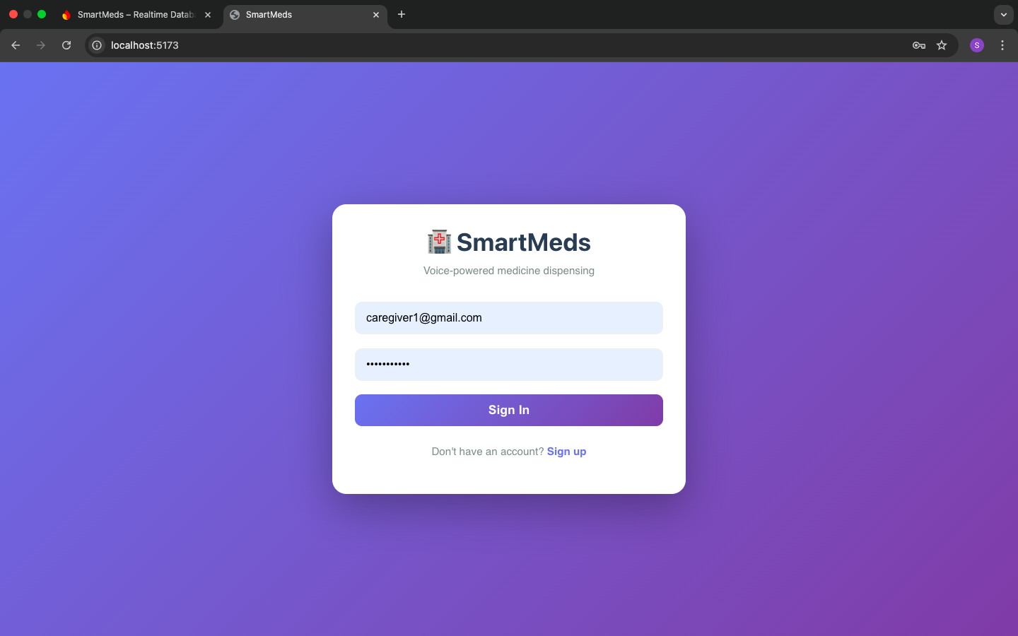
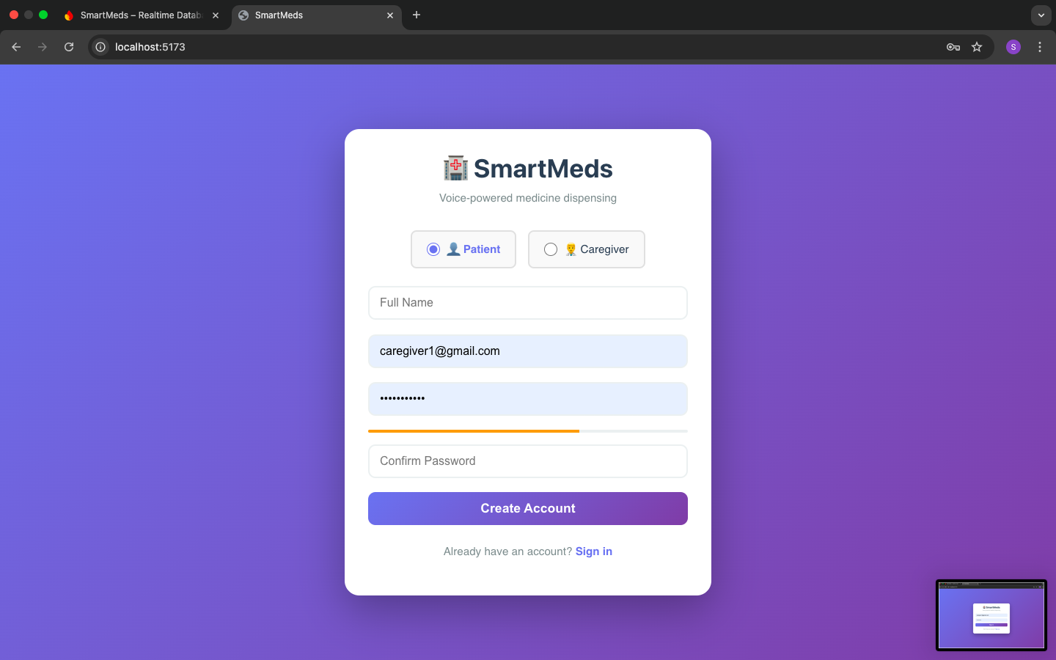
SmartMeds
Screenshots

Slide 35
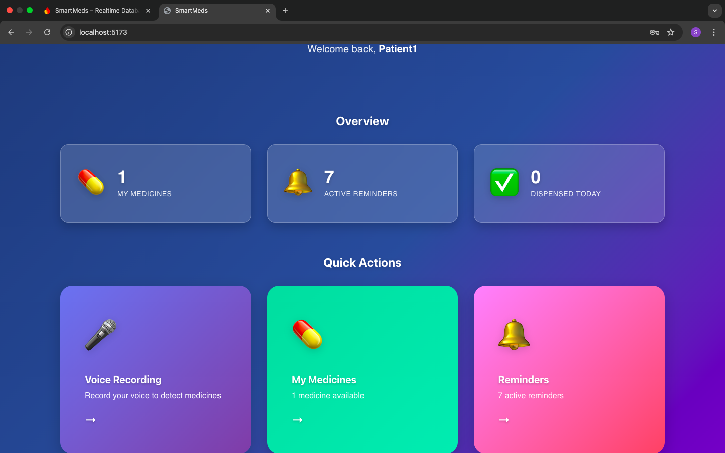
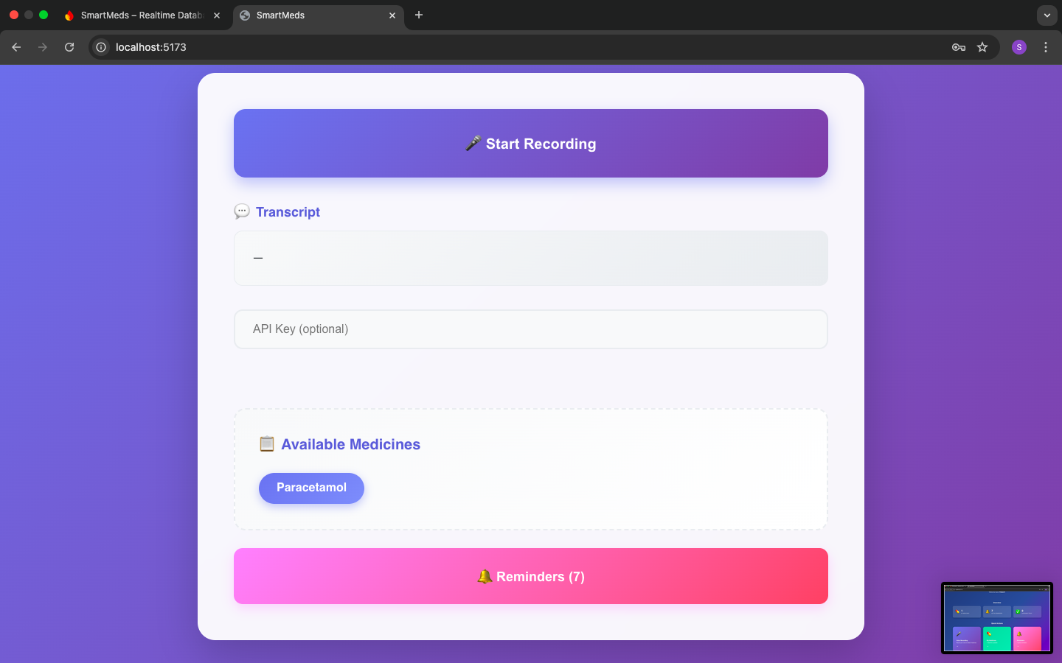
SmartMeds
Screenshots

Slide 36
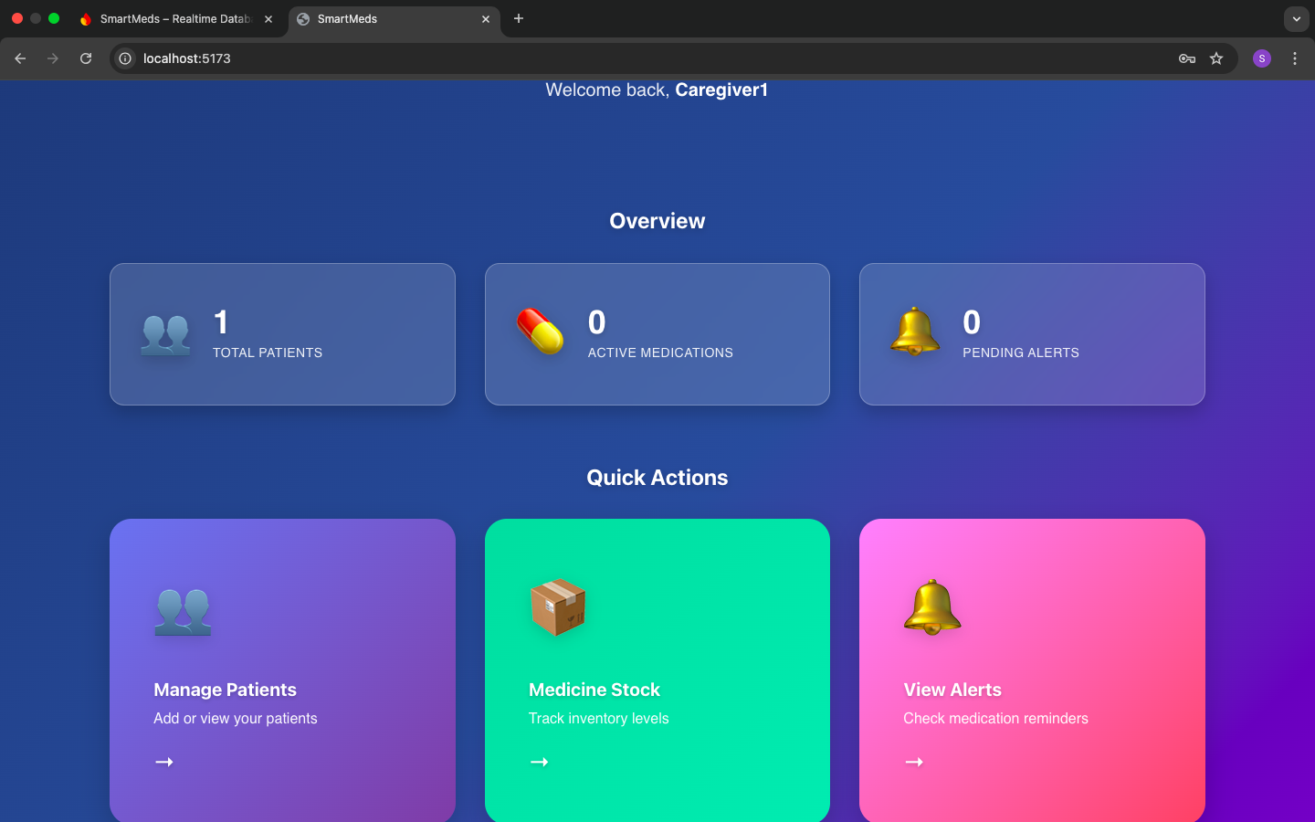
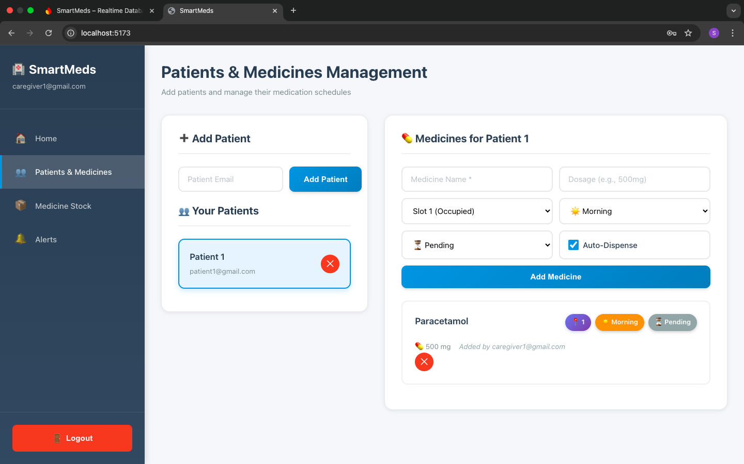
SmartMeds
Screenshots

Slide 37
SmartMeds
Screenshots

Slide 38
SmartMeds
Test Cases
Test Case ID | Test Scenario | Input / Action | Expected Output
FE-01 | User Login | Enter valid credentials | User successfully logged in and redirected to dashboard
FE-02 | Invalid Login | Enter wrong email/password | Error message displayed
FE-03 | Role-Based Access | Login as patient | Patient dashboard is displayed
FE-04 | Role-Based Access | Login as caregiver | Caregiver dashboard is displayed
FE-05 | Voice Recording Start | Click “Start Recording” | Microphone starts recording
FE-06 | Voice Recording Stop | Click “Stop Recording” | Audio recording stops and uploads
FE-07 | Audio Upload | Submit recorded audio | Backend receives audio successfully
FE-08 | Medicine List Fetch | Load dashboard | Medicines fetched from Firebase and displayed
FE-09 | Send Dispense Request | Click dispense button | Success message shown
FE-10 | Logout | Click logout | User logged out and redirected to login

Slide 39
SmartMeds
Test Cases
Test Case ID | Test Scenario | Input / API Call | Expected Output
BE-01 | Process Audio API | POST /process_audio with audio + patient_uid | Returns transcript and medicine details
BE-02 | Invalid Audio Input | Corrupted or missing audio file | Error response returned
BE-03 | Speech-to-Text | Valid voice command | Correct text transcription
BE-04 | NLP Intent Detection | “Dispense paracetamol” | Medicine name and dosage extracted
BE-05 | Medicine Match | Spoken medicine exists in DB | Correct slot and status returned
BE-06 | Medicine Not Found | Unknown medicine name | Error or null response
BE-07 | Send Instruction API | POST /send_instruction | Firebase updated to ready_to_dispense
BE-08 | Invalid Patient UID | Wrong patient_uid | Error response
BE-09 | Firebase Update | Valid medicine request | Status updated with timestamp
BE-10 | API Response Time | Normal load | Response within acceptable time

Slide 40
SmartMeds
References
[1] Raspberry Pi Foundation, Raspberry Pi Documentation, Raspberry Pi Ltd. [Online]. Available: https://www.raspberrypi.com/documentation/.
[2] Python Software Foundation, Python 3 Documentation. [Online]. Available: https://docs.python.org/3/.
[3] Google, Firebase Realtime Database Documentation. [Online]. Available: https://firebase.google.com/docs/database.
[4] Google, Firebase Realtime Database Security Rules. [Online]. Available: https://firebase.google.com/docs/database/security. Accessed: 27-Dec-2025.
[5] K. Reitz et al., Requests: HTTP for Humans – Python Library. [Online]. Available: https://docs.python-requests.org/.
[6] S. Frazier, python-dotenv Documentation. [Online]. Available: https://pypi.org/project/python-dotenv/. Accessed: 27-Dec-2025.
[7] Raspberry Pi Foundation, RPi.GPIO Python Library Documentation. [Online]. Available: https://sourceforge.net/p/raspberry-gpio-python/wiki/Home/.
[8] eSpeak NG Team, eSpeak NG: Open Source Text-to-Speech Engine. [Online]. Available: https://github.com/espeak-ng/espeak-ng.
[9] ALSA Project, Advanced Linux Sound Architecture (ALSA). [Online]. Available: https://www.alsa-project.org/wiki/Main_Page.
[10] GeeksforGeeks, Internet of Things (IoT) – Overview. [Online]. Available: https://www.geeksforgeeks.org/internet-of-things-iot/.
[11] TutorialsPoint, Embedded Systems Tutorial. [Online]. Available: https://www.tutorialspoint.com/embedded_systems/index.htm.
[12] Electronics Tutorials, Servo Motor – Working Principle and Control. [Online]. Available: https://www.electronics-tutorials.ws/io/servo-motor.html.
[13] Electronics Tutorials, DC Motor Basics and Control. [Online]. Available: https://www.electronics-tutorials.ws/dc/dc-motors.html.
[14] IEEE, IoT Applications in Healthcare Systems, IEEE Xplore. [Online]. Available: https://ieeexplore.ieee.org/document/9098167

Slide 41
SmartMeds
References
[1] S. T. George, R. Thomas, and J. Mathew, “An Intelligent Pill Dispenser Using IoT for Chronic Patients,” IEEE International Conference on IoT and Applications, 2020.
Available: https://ieeexplore.ieee.org/document/9359175
[2] N. R. Prasad, S. N. Kumar, and A. Raj, “Smart Medicine Box for Automatic Medication Reminder and Monitoring,” IEEE International Conference on Communication and Electronics Systems, 2021.
Available: https://ieeexplore.ieee.org/document/9519841
[3] A. Chatterjee, M. Sarma, and R. Ghosh, “IoT Based Medication Reminder System for Elderly People,” IEEE International Conference on Computing Methodologies, 2020.
Available: https://ieeexplore.ieee.org/document/9288415
[4] V. S. Reddy, K. Narayana, and M. Kumar, “Voice Enabled Assistive Health Monitoring System,” IEEE International Conference on Inventive Systems and Control, 2021.
Available: https://ieeexplore.ieee.org/document/9398089
[5] M. Shankar, R. Karthik, and S. Vinay, “IoT Based Smart Pill Box with Real-Time Monitoring,” IEEE International Conference on Intelligent Sustainable Systems, 2022.
Available: https://ieeexplore.ieee.org/document/9773136
[6] P. Singh, A. Rana, and M. Khan, “RFID and IoT Based Smart Medicine Dispenser System,” IEEE Access, 2021.
Available: https://ieeexplore.ieee.org/document/9354568
[7] J. Park, Y. Sun, and C. Lee, “Machine Learning Based Elderly Healthcare Assistance System,” IEEE International Conference on Machine Learning and Applications, 2022.
Available: https://ieeexplore.ieee.org/document/10022693
[8] F. Khan, A. Rahman, and R. Basu, “IoT Based Remote Health Monitoring System Using Raspberry Pi,” IEEE International Conference on Computing and Network Communications, 2021.
Available: https://ieeexplore.ieee.org/document/9671026

Slide 42
THANK YOU

